Slide 1
EEG Analysis and Model Prediction
Shrisha Patil

Slide 2
What is EEG?
An electroencephalogram (EEG) is a test used to find problems related to electrical activity of the brain. An EEG tracks and records brain wave patterns.
Small metal discs with thin wires (electrodes) are placed on the scalp, and then send signals to a computer to record the results.
It is typically noninvasive, with the electrodes placed along the scalp, although invasive electrodes are sometimes used, as in electrocorticography.
Doctors use it to help diagnose epilepsy and sleep disorders. However, EEG tests have also increasingly been used to search for patterns between alcoholics and normal people.

Slide 3
About the Data
I used the data which records 10 college students watching MOOC (Massive Open Online Courses) videos.
Online education videos that are assumed not to be confusing for college students, such as videos of the introduction of basic algebra or geometry were extracted. Videos that are expected to confuse a typical college student if a student is not familiar with the video topics like Quantum Mechanics, and Stem Cell Research were also prepared. There were 20 videos, 10 in each category. Each video was about 2 minutes long.
The students wore a single-channel wireless MindSet that measured activity over the frontal lobe. The MindSet measures the voltage between an electrode resting on the forehead and two electrodes (one ground and one reference) each in contact with an ear.

Slide 4
After each session, the student rated his/her confusion level on a scale of 1-7, where one corresponded to the least confusing and seven corresponded to the most confusing.
These labels were further normalized into labels of whether the students are confused or not; Where 1 indicated that the student is confused and 0 indicated that the student is not confused. This label is offered as self-labelled confusion in addition to the predefined label of confusion.
This data is collected from ten students, each watching ten videos. Therefore, it can be seen as only 100 data points for these 12000+ (12811 to be exact) rows. If you look at it this way, then each data point consists of 120+ rows, which is sampled every 0.5 seconds (so each data point is a one minute video). Signals with higher frequency are reported as the mean value during each 0.5 second.

Slide 5
What each parameter means
Column 1: Subject ID
Column 2: Video ID
Column 3: Attention (Proprietary measure of mental focus)
Column 4: Mediation (Proprietary measure of calmness)
Column 5: Raw (Raw EEG signal)
Column 6: Delta (1-3 Hz of power spectrum)

Slide 6
Column 7: Theta (4-7 Hz of power spectrum)
Column 8: Alpha 1 (Lower 8-11 Hz of power spectrum)
Column 9: Alpha 2 (Higher 8-11 Hz of power spectrum)
Column 10: Beta 1 (Lower 12-29 Hz of power spectrum)
Column 11: Beta 2 (Higher 12-29 Hz of power spectrum)
Column 12: Gamma 1 (Lower 30-100 Hz of power spectrum)

Slide 7
Column 13: Gamma 2 (Higher 30-100 Hz of power spectrum)
Column 14: predefined label (whether the subject is expected to be confused)
Column 15: user-defined label (whether the subject is actually confused)

Slide 8
What is Alpha, Beta, Gamma, Theta, Delta?
Your brain actually has 5 brainwaves, each one a distinct electrical pattern which operates even when you’re fast asleep.
For years, doctors and scientists have studied these brain waves using an EEG or electroencephalograph, a complex device which tracks the neuro activity known as brainwaves over 5 different channels.
In all of us, you’ll find the following 5 brainwaves: Gamma, Beta, Alpha, Theta, Delta. Each brainwave has a distinct purpose and helps us behave, think, move and process.
Although they channel automatically, it’s our own ability to modulate between them that determines how well we cope with pressure, rational and irrational thoughts, task management and more.

Slide 9
If our physiology, diet or environment causes an overproduction or underproduction of a certain brainwave, it can alter the balance of our bodies and induce many negative effects such as insomnia, anger, stress, learning difficulties or anxiety.
This is why it’s important to optimise our brains for a better wave balance, rather than aim to increase or decrease a particular one.
DELTA WAVES: Delta waves are associated with deep levels of relaxation and restorative sleep. They are the slowest recorded brain waves in humans and higher levels are more commonly found in young children. During the aging process, lower Delta waves are produced. Research tells us that Delta waves are attributed to many of our unconscious bodily functions such as regulating the cardiovascular and the digestive systems.
THETA WAVES: Theta waves known as the ‘suggestible waves’, because of their prevalence when one is in a trance or hypnotic state. In this state, a brain’s Theta waves are optimal and the patient is more susceptible to hypnosis and associated therapy. The reasoning for this is that Theta waves are commonly found when you daydream or are asleep, thus exhibiting a more relaxed, open mindstate.

Slide 10
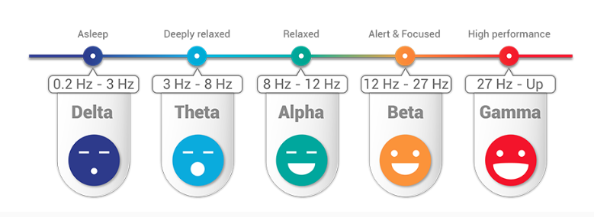
ALPHA WAVES: Alpha waves are the ‘frequency bridge’ between our conscious thinking (Beta) and subconscious (Theta) mind. They are known to help calm you down and promote feelings of deeper relaxation and content.
BETA WAVES: Beta waves are the high frequency waves most commonly found in awake humans. They are channeled during conscious states such as cognitive reasoning, calculation, reading, speaking or thinking.
GAMMA WAVES: Gamma waves are found to be important for learning, memory and processing and they are used as a binding tool for our senses to process new information. In people with mental disabilities, much lower levels of Gamma activity is recorded.

Slide 11
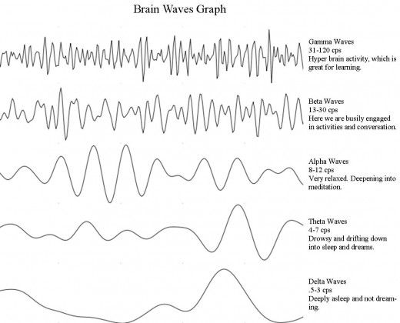

Slide 12
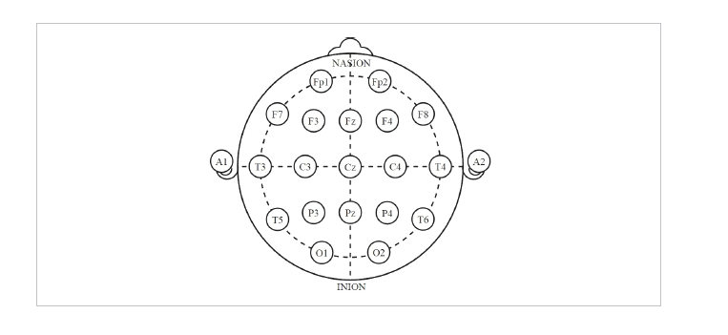
FP: Fronto-polar; F: Frontal; C: Central; P: Parietal; O: Occipital; T: Temporal

Slide 13
Understanding the Data
Power spectral density function (PSD) shows the strength of the variations (energy) as a function of frequency. In other words, it shows at which frequencies variations are strong and at which frequencies variations are weak. The unit of PSD is energy per frequency and you can obtain energy within a specific frequency range by integrating PSD within that frequency range.
Electrical power shows total energy of a power waveform. Power spectrum is the squared frequency spectrum (Fourier transform of the signal which has the dimension of microvolts). The resulting dimension is uV^2 (microvolts squared) (or uV^2/Hz for density). Power is energy per unit of time. Power is simply the magnitude square of the current or voltage in the signal.
A power spectrum specifically defines the distribution of this magnitude with respect to frequency.

Slide 14
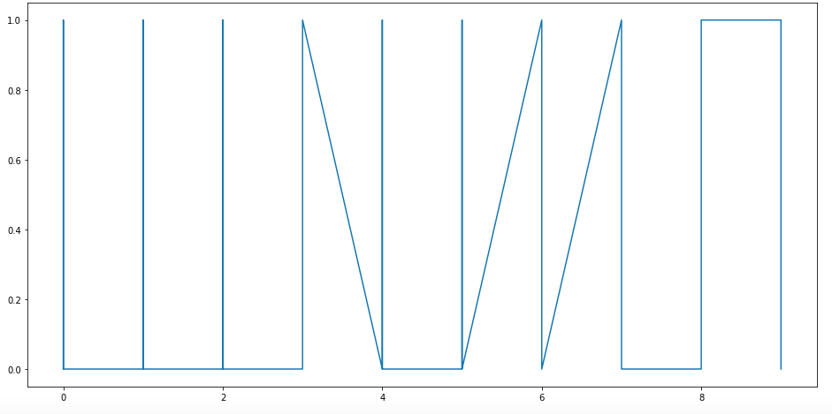
The Original Data

Slide 15
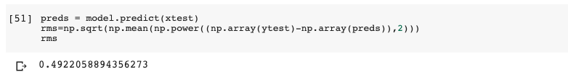
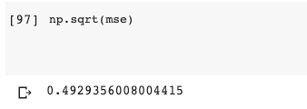
Linear Regression Model
I used 2 methods from Linear Regression to try and create the model for the dataset.

Slide 16
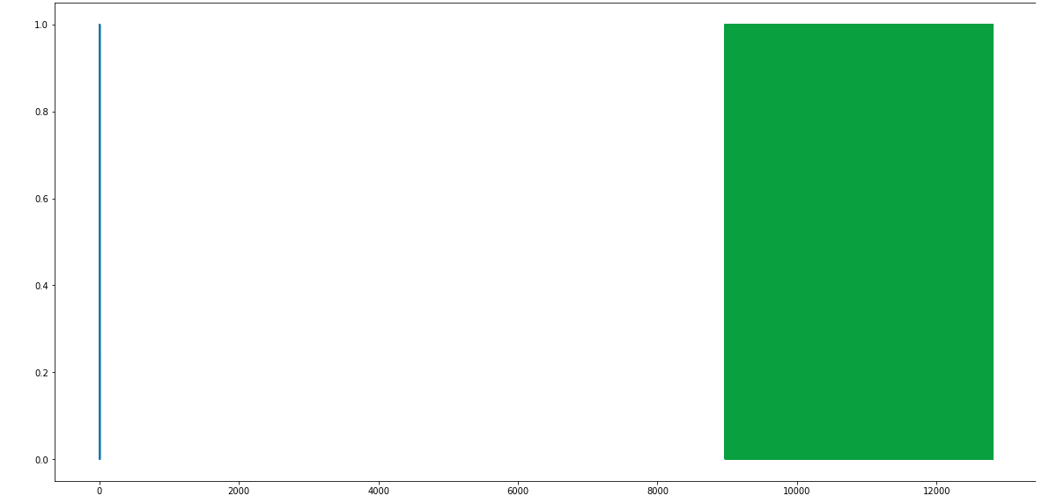
As we can see, both the methods have almost the exact same values, which is approximately 0.493.
Plot for Linear Regression

Slide 17
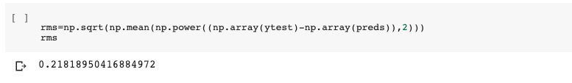

KNN Model
The Root Mean Square Error (RMSE) value was found to be around 0.218
However, the actual accuracy of the model was 93.7%.

Slide 18
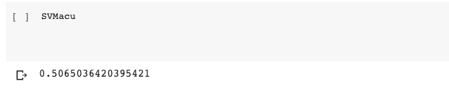
SVM Model
The accuracy of the SVM model was found to be approximately 50.65%, which is much lower when compared to that of the KNN model.

Slide 19
Naive Bayes’ Model
Under Naive Bayes’ algorithm, we have 3 different subdivisions. They are:
Bernoulli Naive Bayes : It assumes that all our features are binary such that they take only two values. Means 0s can represent “word does not occur in the document” and 1s as "word occurs in the document" .
Multinomial Naive Bayes : Its is used when we have discrete data (e.g. movie ratings ranging 1 and 5 as each rating will have certain frequency to represent). In text learning we have the count of each word to predict the class or label.
Gaussian Naive Bayes : Because of the assumption of the normal distribution, Gaussian Naive Bayes is used in cases when all our features are continuous.

Slide 20


For Gaussian NB, we have the accuracy of the model as 54.53%.
For Bernoulli NB, the accuracy is 58.29%.

Slide 21

For Multinomial NB, we have the accuracy of the model as 57.73%.
Therefore, out of the three types of Naive Bayes’ algorithms, the Bernoulli Naive Bayes’ algorithm has the highest accuracy of 58.29%. This accuracy has a higher accuracy than the SVM model and the Linear Regression model; However, the KNN model still has a higher accuracy og 90.73%

Slide 22
MultiLayer Perceptron Model
A multilayer perceptron (MLP) is a deep, artificial neural network. It is composed of more than one perceptron.
They are composed of an input layer to receive the signal, an output layer that makes a decision or prediction about the input, and in between those two, an arbitrary number of hidden layers that are the true computational engine of the MLP.
MLPs with one hidden layer are capable of approximating any continuous function.
Multilayer perceptrons are often applied to supervised learning problems: they train on a set of input-output pairs and learn to model the correlation (or dependencies) between those inputs and outputs.

Slide 23
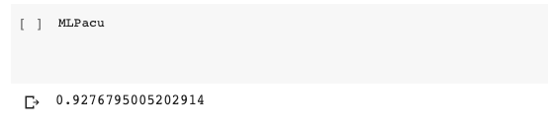
Using the MLP model on the EEG dataset, the accuracy of the model is found to be 92.77%
So, we can see that the MLP model has just 1% less accuracy than the KNN model.

Slide 24
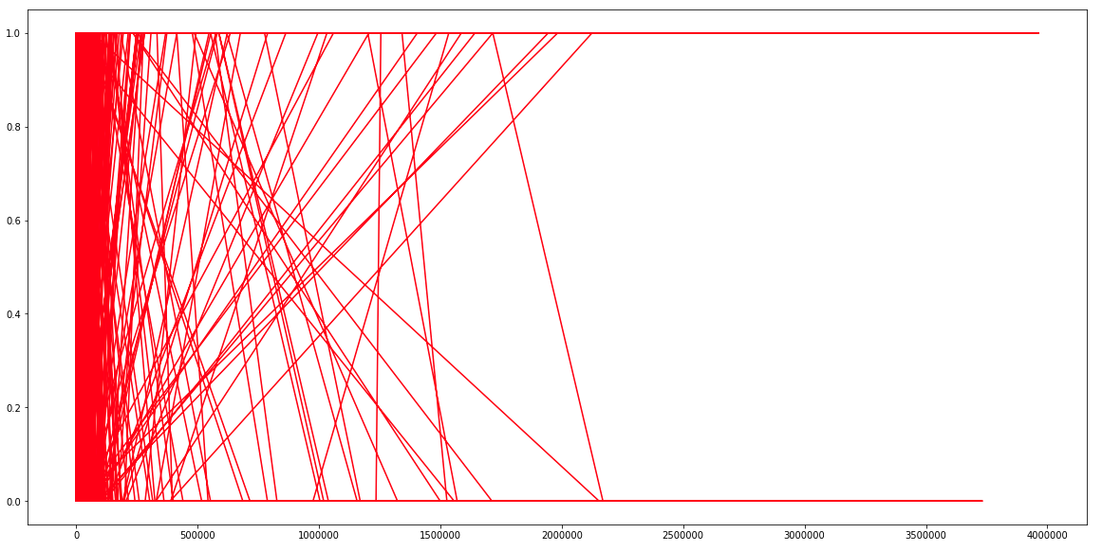
Plot of x_data vs y_output

Slide 25
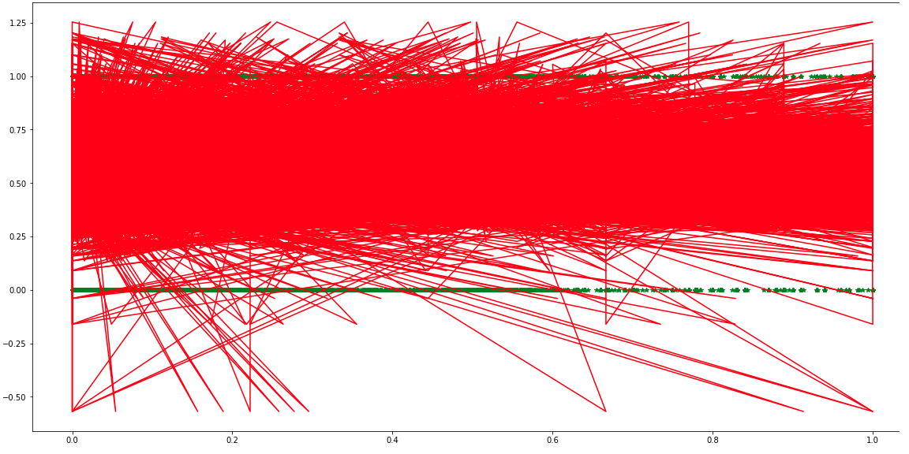
Plot of x_test vs y_test

Slide 26
Conclusion
Thus, from all the various models that were used on the EEG dataset, we found the KNN model to have the highest accuracy, closely followed by the MLP model.
The Linear Regression Model has the worst accuracy at 49.29%.

